Slide 1
Early Childhood Education and Care
Licensing criteria guide
April 2026

Slide 2
Introduction
This presentation gives an overview of the purpose of licensing criteria for early childhood education and care services. It explains why the criteria have been updated, what has changed, and which changes are most likely to affect your service from 20 April 2026.
It also shows you how to find the updated licensing criteria and guidance on the Ministry of Education’s website, so you can easily access the information you need to understand and meet your obligations.

Slide 3
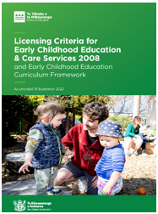
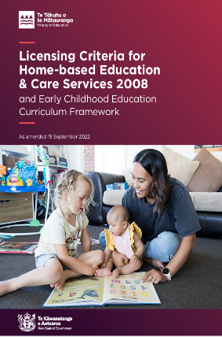
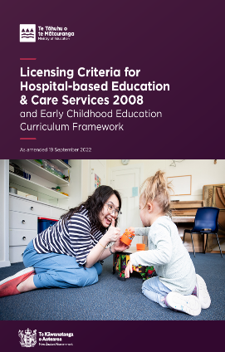

About licensing criteria
Licensing criteria are part of regulatory framework for early childhood education and care services in Aotearoa New Zealand. They are compulsory requirements that services must meet to be granted and keep a licence.
The criteria:
protect children’s health, safety, wellbeing, and learning
are used to assess compliance with minimum standards set out in the regulations and are directly linked to legislation and regulations
show what the regulations look like in everyday practice – things that can be observed, checked, and evidenced.
ensure consistent minimum standards across all services.

Slide 4
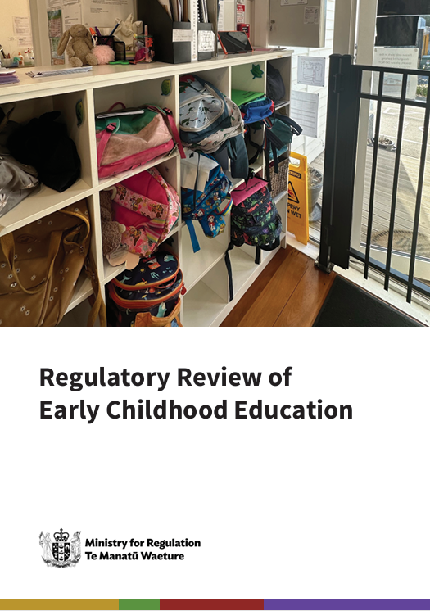
Why are licensing criteria changing?
On 31 March 2025, Cabinet agreed to the Ministry for Regulation’s recommendations from its review of early childhood education.
Recommendation 9 was to “revise licensing criteria to ensure they are proportionate, effective, and support quality without overburdening providers”.
The Ministry of Education consulted on the proposed changes in 2025 before the Minister made a final decision.
The updated licensing criteria were published in the New Zealand Gazette in November 2025.
From 20 April 2026, the updated licensing criteria will apply to centre‑based services (excluding Te Kōhanga Reo*), home‑based services, and hospital‑based services.
You can read more about the Ministry for Regulation’s review here:
Early Childhood Education (ECE) regulatory sector review | Ministry for Regulation
*Te Kōhanga Reo has its own set of licensing criteria. We are working with the Kōhanga Reo National Trust Board to consider any changes in the future

Slide 5
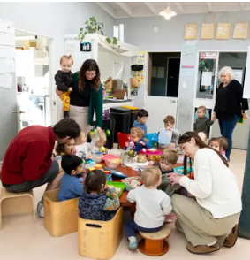
Key changes from 20 April 2026
The purpose of the criteria remains the same - to make sure children learn and play in safe, quality environments.
What has changed
All criteria have been renumbered for clarity, with:
  centre-based in the 100s
  home-based in the 200s
  hospital-based in the 300s
Many criteria have updated wording
Some criteria have been removed, and some merged.
Please note: Curriculum criteria have an identification number change only. There are no changes to the curriculum criteria wording or associated guidance.

Slide 6
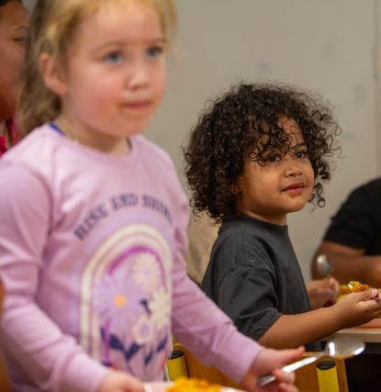
Key changes from 20 April 2026 (cont.)
Greater focus on practice
A deliberate shift toward practice‑focused assessment.
Policies and procedures are required to be implemented and regularly reviewed.
From universal to targeted
Some criteria now apply only to specific groups
For example, new sector entrants or providers not registered under NP2 of the Food Act.

Slide 7
Most impactful changes – Health and Safety
Criterion | Change type | Service type | Old/new identification number | Impact of change
Health and Safety
Emergency Drills | Changed | Centre-based Home-based Hospital-based | HS8 / HS106 HS7 / HS205 HS4 / HS304 | Extended the frequency of emergency drills from 3 to 4 months.
Room Temperature | Changed | Centre-based Home-based Hospital-based | HS24 / HS118 HS21 / HS205 HS8 / HS308 | The minimum temperature requirement of no lower than 18°C has been retained, with added clarification allowing brief temperature fluctuations and clarification of thermometer location.
Medicine Administration | Changed | Centre-based Home-based | HS28 / HS122 HS25 / HS219 | Reduces the documentation compliance burden for services by reducing the frequency of parental authorisation needed for medicine administration.

Slide 8
Most impactful changes – Health and Safety (cont.)
Criterion | Change type | Service type | Old/new identification number | Impact of change
Health and Safety continued
Child protection | Changed | Centre-based Home-based Hospital-based | HS31 / HS125 HS28 / HS222 HS13 / HS312 | New wording with an explicit requirement that the policy and procedure are implemented. The three yearly review must include evaluation of a real or hypothetical scenario to assess effectiveness. Documentation can be written or digital.
Notification | Changed | Centre-based Home-based | HS34 / HS128 HS33 / HS227 | New wording with a requirement to notify the Ministry when the child protection policy requires it. Four specific types of incidents become mandatory to notify the Ministry about. Broader documentation requirements.

Slide 9
Most impactful changes – Premises and Facilities
Criterion | Change type | Service type | Old/new identificationnumber | Impact of change
Premises and facilities
Tempering valve | Removed | Centre-based | PF24 | The explicit requirement for a tempering valve (or equivalent device to limit hot water temperature) has been removed. Services are still required to make sure hot water temperatures are safe for children.
First aid kit | Changed | Centre-based | PF28 / PF123 | The prescriptive appendix 1 list is removed and replaced by a sufficiency based requirement, with a system for review and replenishment. This provides flexibility around compliance.
Kitchen facilities | Changed | Centre-based | PF16 / PF115 | Updated to reflect Ministry for Primary Industries requirements, and targeted to only services who are not registered with NP2 under the Food Act 2014 to reduce duplication.
 |  | Home-based | PF13 / PF212 | Updated wording to reflect Ministry for Primary Industries requirements, but there is no NP2 exemption as homes aren’t regulated in the same way under the Food Act 2014.

Slide 10
Most impactful changes - GMA
Criterion | Change type | Service type | Old/new identification number | Impact of change
Governance, Management & Administration
Philosophy statement | Removed | Centre-based | GMA5 | Services are no longer required to maintain a written philosophy statement.
 |  | Home-based | GMA4
 |  | Hospital-based | GMA5
Human resource management | Changed | Centre-based Home-based | GMA7 / GMA105 GMA6 / GMA204 | Reduces the number of requirements and duplication with the Labour Inspectorate
Annual plan and annual budget | Changed | Centre-based | GMA8 / GMA107 GMA9 / GMA108 | Targeted requirements to new entrants (service providers) to the ECE sector. This means existing service providers that wish to expand the number of licensed services they operate will no longer be required to provide these, reducing the compliance burden.
 |  | Home-based | GMA7 / GMA206 GMA8 / GMA207
 |  | Hospital-based | GMA8 / GMA307 GMA9 / GMAS308

Slide 11
Most impactful changes - GMA (cont.)
Criterion | Change type | Service type | Old/new identification number | Impact of change
Governance, Management & Administration
Information provided to parents | Changed | Centre-based | GMA1, GMA2 and GMA3 GMA101, GMA102 and GMA103 | Shift in approach: The number of documents to be displayed has been reduced. Instead, information provided to parents can now be in written or digital form.
 |  | Home-based | GMA1 / GMA201
 |  | Hospital-based | GMA1, GMA2 and GMA3 GMA301, GMA302 and GMA303
Operational review | Changed | Centre-based | GMA6 / GMA104 | Narrowed focus: The criterion shifts from broad self review and internal evaluation of education, care, and quality improvement to a targeted review of operational policies and practices to ensure they meet minimum standards, with action taken where they do not. Services may still undertake self review and internal evaluation if they choose, but this is not a licensing requirement and will not be reviewed under this criterion.
 |  | Home-based | GMA5 / GMA203
 |  | Hospital-based | GMA6 / GMA304

Slide 12
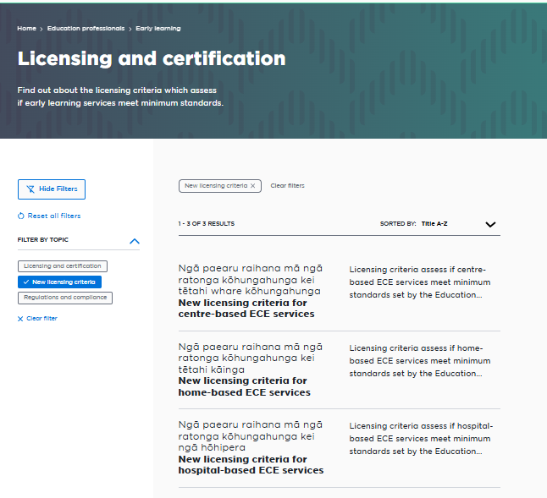
Website information on the new licensing criteria
For each service type, you can access:
The licensing criteria you must meet
Practical guidance to help you meet and go beyond compliance
You can also find:
A PDF copy of the licensing criteria
A comparison table showing the current and updated criteria side by side

Slide 13
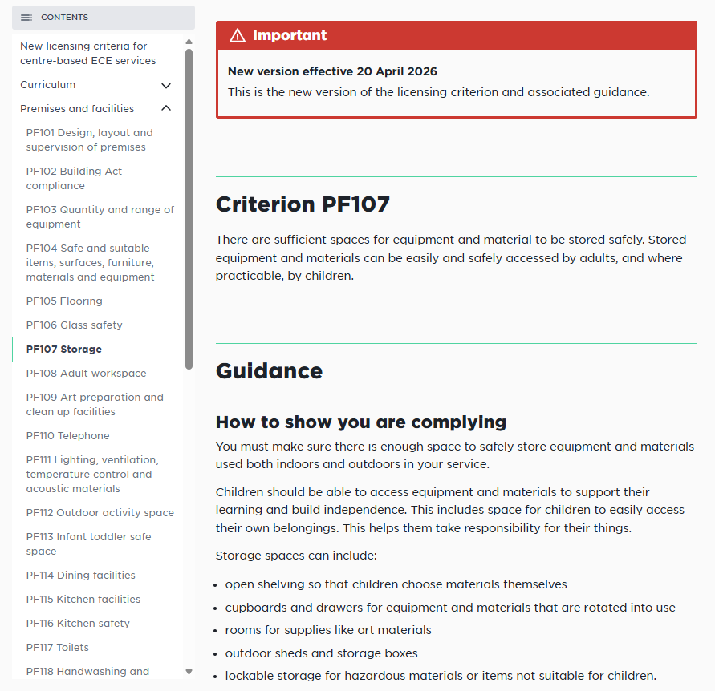
What you’ll find for each criterion
Each licensing criterion webpage includes:
Guidance: Plain‑language explanations of what the requirement means in practice.
How to show compliance: Examples of evidence or practices that demonstrate compliance.
How we assess: What assessors may ask, look for or request.
Tools to help you comply: Templates, checklists, and useful resources.
Some pages include a section for Best practice, with suggestions to go beyond compliance and improve quality and outcomes.

Slide 14
Key links for service providers
Ministry of Education
www.education.govt.nz
Early Learning
Early learning - Ministry of Education
Licensing and certification
Licensing and certification - Ministry of Education
New centre-based licensing criteria
New licensing criteria for centre-based ECE services - Ministry of Education
New home-based licensing criteria
New licensing criteria for home-based ECE services - Ministry of Education
New hospital-based licensing criteria
New licensing criteria for hospital-based ECE services - Ministry of Education

